Slide 1

Introduction to GraphQL with Hotchocolate
A comprehensive guide to building efficient, type-safe APIs for .NET developers
Presented By:
SHIVAM SHARMA shivam.sharma@taazaa.com

Slide 2

Agenda:
Introduction of Graphql and it's usability with .Net libraries.
Core GraphQL Concepts like Queries, Mutations, Schema and Types
GraphQL in action with demo application.
An overview of few advanced Graphql concepts
Q&A

Slide 3

What is GraphQL?
GraphQL is a query language and runtime for APIs created by Facebook(now Meta) in 2015, designed to solve common API development challenges.
1
2
Precise Data Fetching
Strong Type System
Clients specify exactly what data they need, eliminating over-fetching problems common in REST APIs
Uses a robust schema to define all possible data types and operations, enabling powerful tooling and validation
3
Single Endpoint
All API operations go through a single HTTP endpoint, simplifying routing and API management

Slide 4
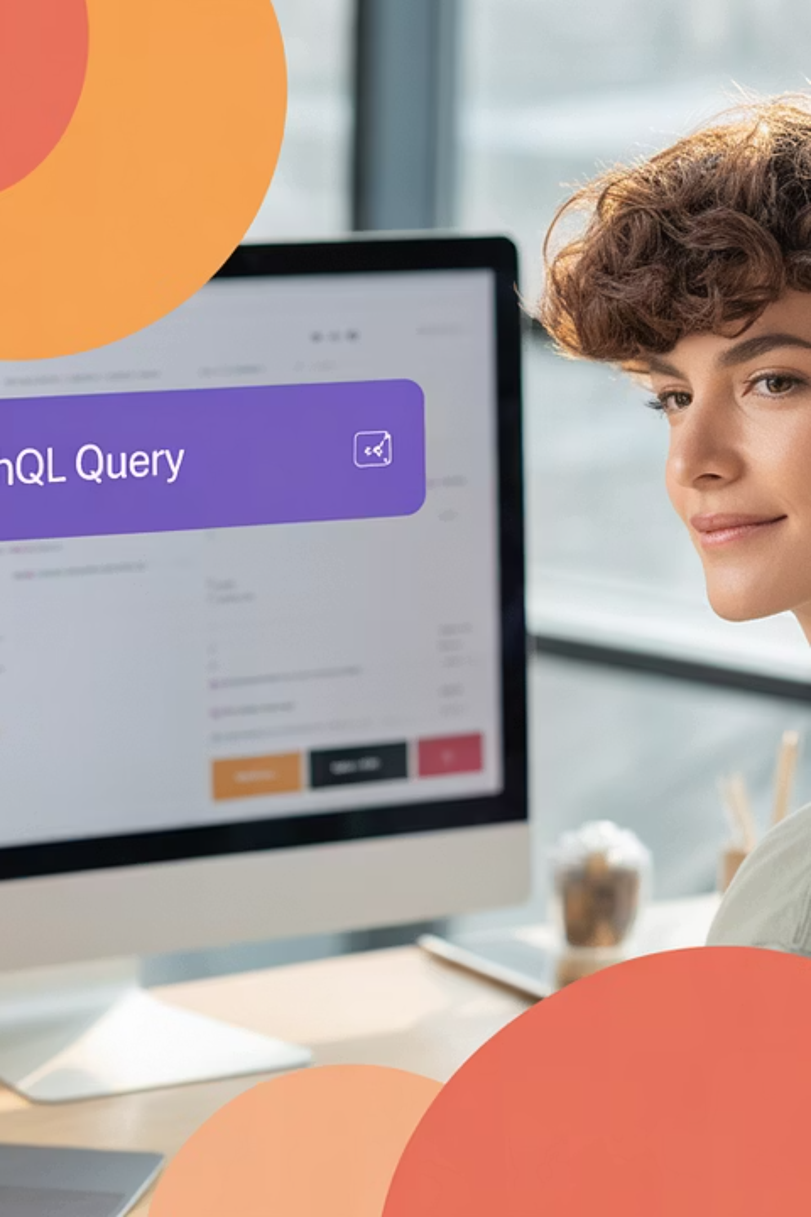
Why GraphQL?
Solves REST Limitations
Developer Experience
Eliminates common REST API problems:
Enhances productivity with:
Self-documenting schema through introspection
Over-fetching: receiving more data than needed
Advanced tooling like GraphiQL and Banana Cake Pop
Under-fetching: requiring multiple API calls for related data
Strong typing throughout the entire stack
Endpoint proliferation: managing numerous specialized endpoints
Architecture Benefits
Ideal for modern architectures:
Microservices integration via schema stitching
BFF (Backend for Frontend) pattern implementation
Efficient mobile app data fetching
Notes:
Under fetching:
GET /users/1 → returns user info
GET /users/1/orders → returns the user’s orders
GET /orders/101/items → returns order item details
GraphQL Solution:
graphql
CopyEdit
query { user(id: 1) { name orders { total items { name price } } } }
🧩 2. Endpoint Proliferation
Problem: REST APIs often create many narrowly-scoped endpoints for different views or use cases.
💬 Example in REST:
/products
/products/featured
/products?category=books&limit=5
/products/popular?region=IN
Each endpoint might serve a different UI need — leading to duplication and maintenance overhead.
GraphQL Solution:
GraphQL uses a single endpoint (e.g., /graphql) and allows clients to shape the response using queries.
graphql
CopyEdit
query { products(filter: { category: "books" }, first: 5) { name price isFeatured } }
Schema Stitching is a technique in GraphQL where you combine multiple GraphQL schemas into a single unified schema, allowing clients to query data across multiple services through a single endpoint.
🔧 Why Schema Stitching?
Breaks a large monolithic GraphQL schema into smaller, modular services.
Useful in microservices architectures, where each domain has its own GraphQL API.
Enables cross-service relationships (e.g., linking a User from Service A with Orders from Service B).
Allows independent teams to own and evolve their part of the API. Schema Introspection in GraphQL is a built-in feature that allows clients (or tools) to query the schema itself — to discover:
What types, queries, mutations, and fields exist
What arguments, return types, and descriptions are available
Which fields are nullable, deprecated, or secured

Slide 5
REST vs GraphQL
Feature
REST
GraphQL
Endpoints
Multiple URLs
Single URL
Versioning
Often required (v1, v2)
Schema evolution supported
Query Shape
Fixed by endpoint
Client-defined
Documentation
Manual (Swagger/OpenAPI)
Auto-generated via schema
Overhead
High for deep data
Low, tailored data fetch
Learning Curve
Simple concepts
Steeper initial learning
Caching
Simple (URL-based)
Complex (query-based)
Error Handling
HTTP status codes
Detailed error objects
GraphQL excels in providing precise data delivery at the cost of initial complexity, while REST offers simpler implementation with potential inefficiencies.

Slide 6
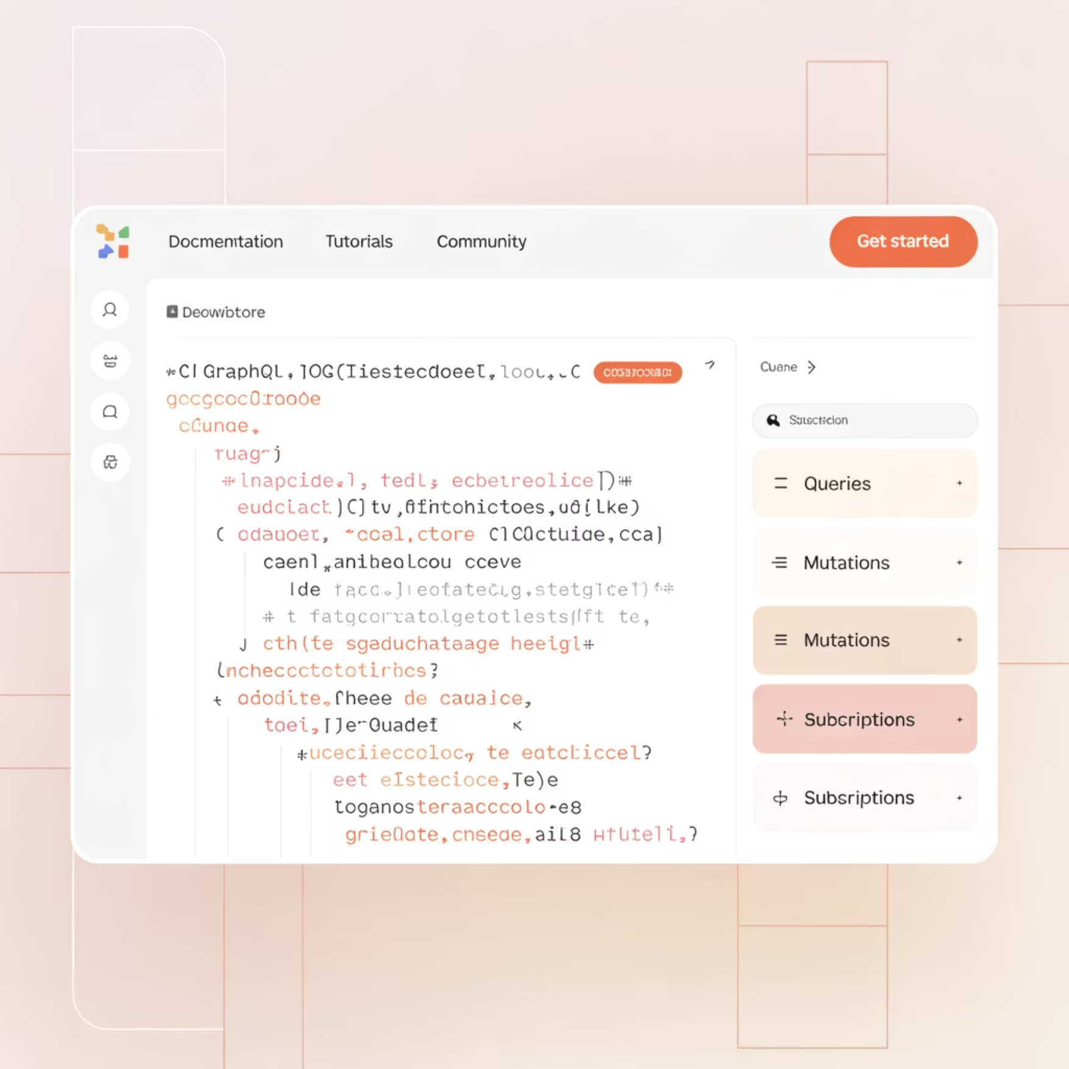
GraphQL in .NET Ecosystem
Available Libraries:
GraphQL.NET - Classic, mature implementation
HotChocolate - Modern, feature-rich framework
ZeroQL - Experimental, type-safe client generation
HotChocolate stands out as the premier choice for .NET developers,
with deep ecosystem integration and robust features.
ASP.NET Core Integration
Entity Framework Support
Seamlessly fits into dependency injection, middleware pipeline, and hosting patterns
First-class EF Core integration with projections and filtering
Azure & Cloud Ready
Tooling Ecosystem
Functions, App Service, and container deployment options
Banana Cake Pop IDE, schema registry, and Fusion gateway
Notes:
Projections refer to the practice of selecting only the fields requested by the client when querying the database — instead of retrieving entire entities.
In other words: only fetch what the query actually asks for.
Good Approach (with projection):
Using HotChocolate’s built-in [UseProjection] middleware:
csharp
CopyEdit
[UseProjection] public IQueryable<Course> GetCourses() => _db.Courses;
✅ HotChocolate inspects the incoming query and builds a LINQ Select() expression to fetch only necessary fields.

Slide 7
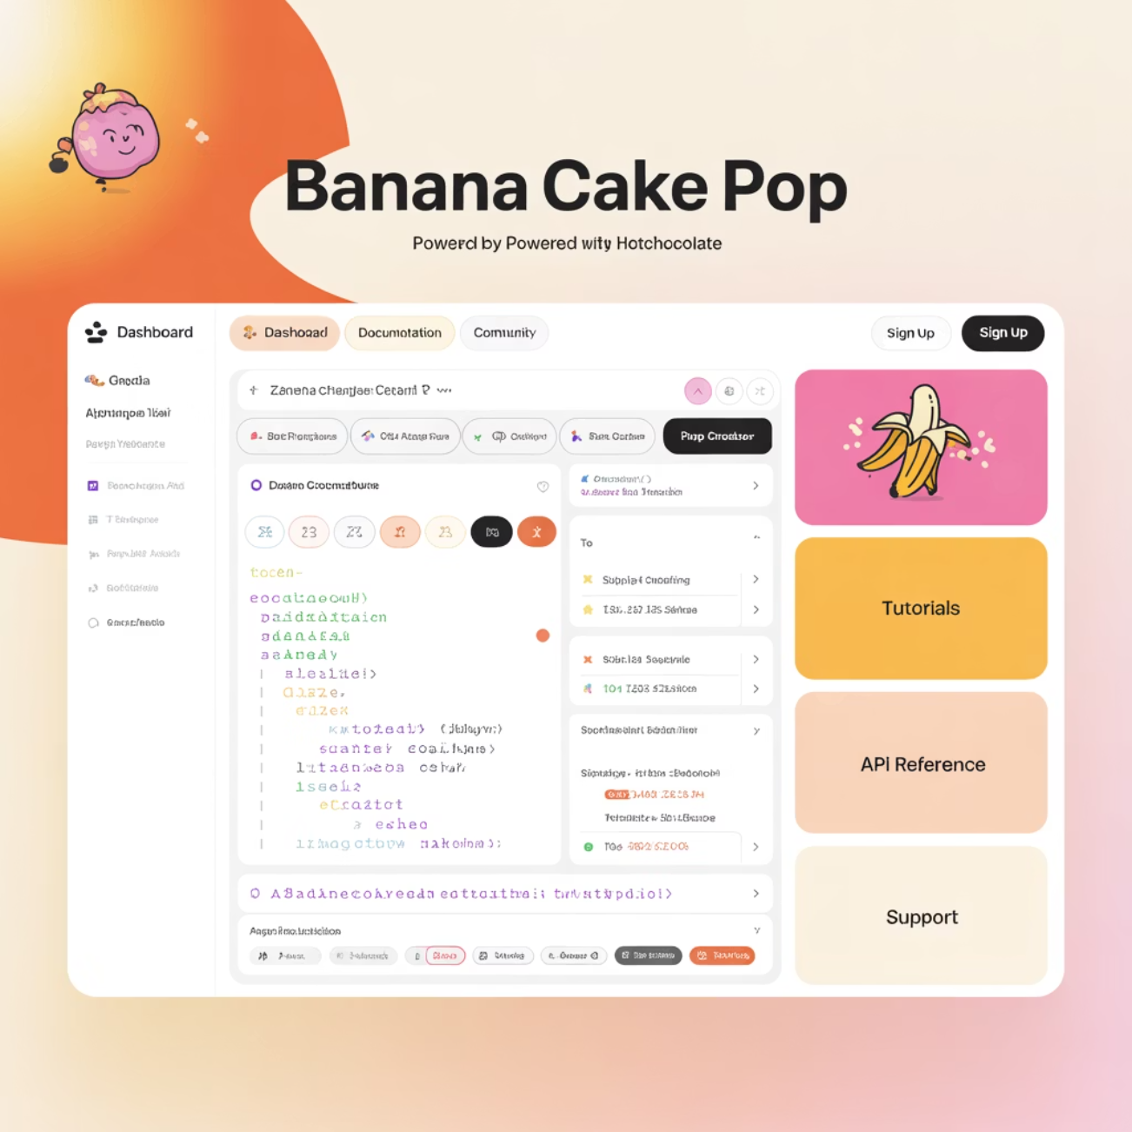
Why HotChocolate?
Development Models
Declarative Middleware
Supports both code-first (C# classes) and schema-first (SDL) approaches, allowing teams to choose their preferred style
Attribute-based configuration for common patterns:
[UsePaging] [UseFiltering] [UseSorting] [Authorize]
Enterprise Features
Built-in solutions for subscription handling, data loading optimization, federation, and schema stitching
HotChocolate has become the standard for GraphQL in .NET due to its comprehensive feature set and excellent developer experience.
Notes:
Schema-First Approach
You write the GraphQL Schema Definition Language (SDL) manually and bind C# resolvers to it.
Example SDL (schema.graphql):
graphql
type Course { id: Int! title: String! } type Query { getCourse(id: Int!): Course }
Then bind it to your resolvers:
builder.Services .AddGraphQL() .AddDocumentFromFile("schema.graphql") .BindRuntimeType<Course>("Course") .BindRuntimeType<CourseQueries>("Query"); What is Federation in GraphQL?
GraphQL Federation is an architecture that allows you to compose multiple independent GraphQL services (subgraphs) into a single unified schema — known as a supergraph.
It enables teams to own and deploy their GraphQL APIs independently, while exposing a single API gateway to clients.
Problem It Solves
In large-scale systems:
Monolithic GraphQL schemas become hard to maintain.
Multiple teams need autonomy over parts of the API.
Stitching schemas manually (with schema stitching) can be fragile and tightly coupled.

Slide 8
Schema & Type System
The GraphQL schema is the contract between client and server, describing all available types and operations.
type Course {
id: ID!
title: String!
description: String
instructor: User!
students: [User!]!
difficulty: DifficultyLevel!
}
enum DifficultyLevel {
BEGINNER
INTERMEDIATE
ADVANCED
}
Scalar Types
1
Primitive values: Int, Float, String, Boolean, ID
Object Types
2
Custom structures with fields (like classes)
Input Types
3
Objects used as arguments in operations
The ! indicates non-nullable fields, while [ ] represents lists. These type definitions create a strongly-typed API contract.
Advanced Types
4
Enums, Interfaces, Unions for complex scenarios

Slide 9
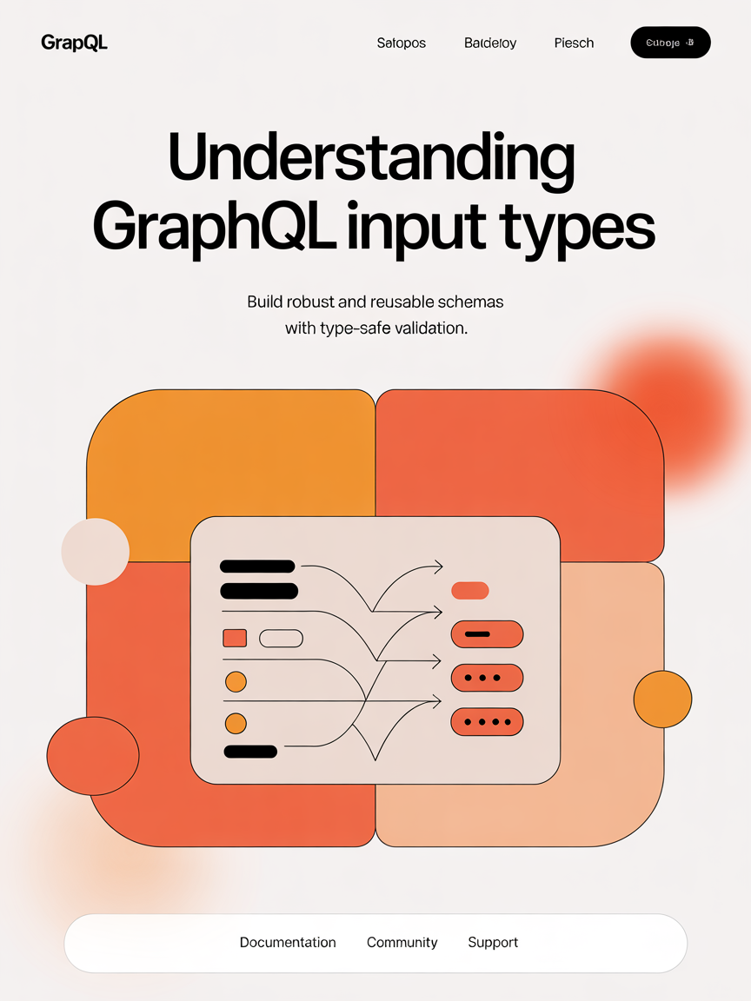
Input Types & Arguments
// GraphQL SDL
input CourseInput {
title: String!
description: String
instructorId: ID!
difficulty: DifficultyLevel
}
// HotChocolate C# Code
public class CourseInput
{
[Required]
public string Title { get; set; }
public string Description { get; set; }
[Required]
public Guid InstructorId { get; set; }
public DifficultyLevel Difficulty { get; set; }
}
Type Safety
Input types provide strict validation of client-provided data
Validation Integration
Works with standard .NET validation:
Data Annotations
FluentValidation
Custom validation logic
Reusability
Input types can be reused across multiple mutations and queries

Slide 10
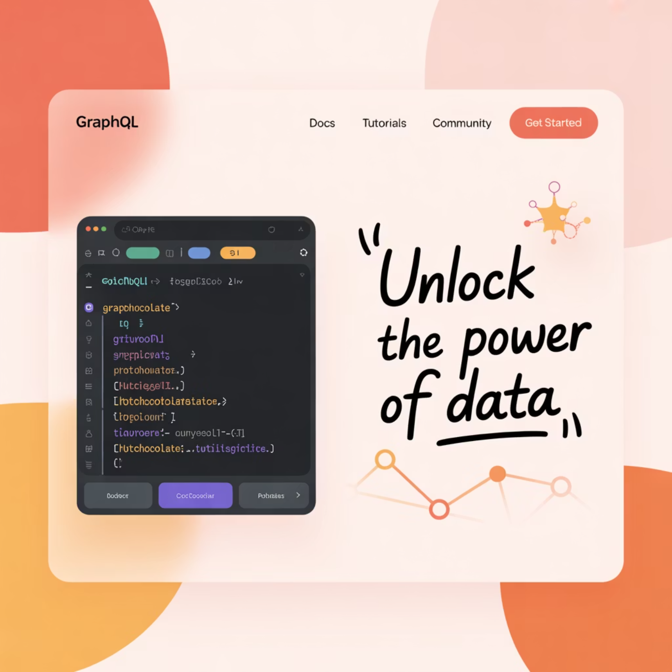
Defining Schema in Code
// Program.cs
var builder = WebApplication.CreateBuilder(args);
builder.Services
.AddDbContext()
.AddGraphQLServer()
.AddQueryType()
.AddMutationType()
.AddSubscriptionType()
.AddType()
.AddFiltering()
.AddSorting()
.AddProjections()
.AddAuthorization();
// Course Type Definition
public class CourseType : ObjectType
{
protected override void Configure(
IObjectTypeDescriptor descriptor)
{
descriptor.Field(c => c.Id).ID();
descriptor.Field(c => c.Title);
descriptor.Field(c => c.Description);
descriptor.Field(c => c.Instructor)
.ResolveWith(r =>
r.GetInstructor(default!, default!));
}
}
Code-First Approach
Define GraphQL schema using C# classes and attributes, ideal for .NET developers
Schema-First Option
Alternatively, define schema using GraphQL SDL and bind to resolver implementations
Type Configuration
Fine-grained control over field exposure, resolvers, and middleware
Notes:
You bind SDL to C# by linking the SDL operation names to the corresponding C# methods.
🔧 Step-by-Step:
➊ Load the SDL: builder.Services .AddGraphQL() .AddDocumentFromFile("schema.graphql");
➌ Bind types to runtime:builder.Services
.AddGraphQL()
.BindRuntimeType<Course>("Course")
.BindRuntimeType<QueryResolvers>("Query")
.BindRuntimeType<MutationResolvers>("Mutation")
.BindRuntimeType<CourseInput>("CourseInput"); Why Use SDL?
Separates schema from implementation — great for contract-first design.
Enables frontend-driven API development.
Encourages better API reviews and documentation.
Works well in federated or stitched schema environments.
Tips & Best Practices
Use .graphql files for schema versioning and diffs.
Validate SDL syntax with tools like GraphiQL or Banana Cake Pop.
Combine schema-first with code-first if needed (hybrid model).

Slide 11

Demo Overview
Technical Stack
Backend
Development Tools
.NET Core 6.0
Banana Cake Pop (GraphQL IDE)
HotChocolate 12.x
Visual Studio or VS Code
Entity Framework Core
Docker for local services
SQL Server (or PostgreSQL)
Project Structure
GraphQL/Types/ - Domain objects
GraphQL/Queries/ - Read operations
GraphQL/Mutations/ - Write operations
GraphQL/Inputs/ - Input models
Our demo application is a Course Management System that showcases HotChocolate's capabilities in a real-world scenario.
GraphQL/Subscriptions/ - Real-time updates

Slide 12
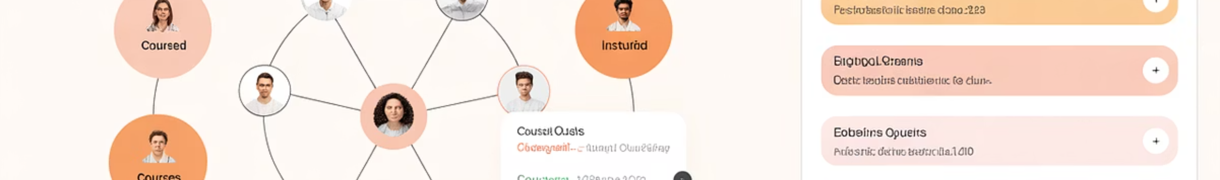
Queries in GraphQL
Client Request
Server Implementation
query {
courses {
title
instructor {
name
email
}
}
}
[ExtendObjectType(Name = "Query")]
public class CourseQueries
{
public IQueryable GetCourses(
[Service] AppDbContext db)
{
return db.Courses.Include(c => c.Instructor);
}
}
Clients request exactly the fields they need, with nested relations in a single call.
HotChocolate maps queries via attributes or naming conventions, integrating with dependency injection.

Slide 13
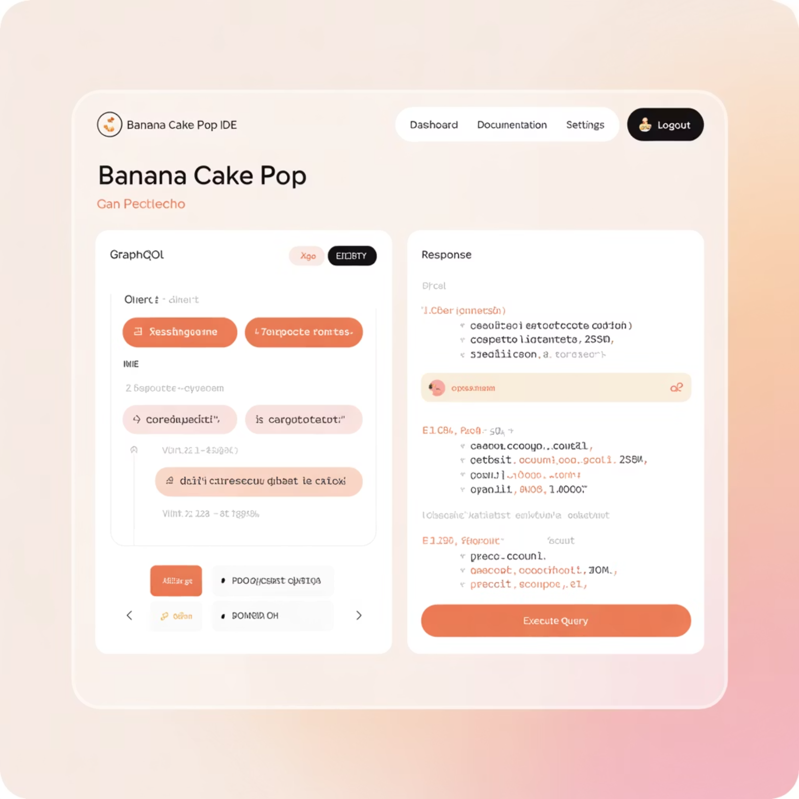
Running a Query
Key Features
Schema Explorer - Browse all available types and operations
IntelliSense - Field autocompletion based on schema
Documentation - Inline descriptions for fields and types
Request History - Save and reuse previous queries
HTTP Headers - Test authentication and custom headers
Variables - Test with different input values
Performance Metrics - See execution time and response size
The schema introspection feature allows tooling to discover all available operations without manual documentation.
Banana Cake Pop provides a rich development environment for testing and exploring your GraphQL API.

Slide 14




Resolvers & Execution Flow
Parse Query
Validate
Client query is parsed into an abstract syntax tree (AST)
Query is validated against the schema to ensure it's valid
Execute
Response
Resolvers are invoked for each requested field
Results are assembled into a JSON response
Resolver Features
Middeware Pipeine
Support for async/await operations
public class UserMiddleware
{
public const string USER_CONTEXT_DATA_KEY = "User";
private readonly FieldDelegate _next;
public UserMiddleware(FieldDelegate next)
{
_next = next;
}
public async Task Invoke(IMiddlewareContext context)
{ //Fetch the user info from context using claims in the context.
await _next(context); } }
Dependency injection for services
Context access for auth/user info
Field-level resolution granularity
Notes:
GraphQL resolvers are always field-based at runtime.
You can group field resolvers by type (in resolver classes).
You can resolve a complete object in the Query or parent field resolver — but individual fields still get called.
Use [UseProjection], batching, or dataloaders to avoid N+1 queries.

Slide 15
Resolver in Action
Client Request
Query Resolver
query {
courseById(id: "1") {
title
description
instructor {
name
}
enrollments {
student {
name
}
enrollmentDate
}
}
}
public Course GetCourseById(Guid id,[Service] AppDbContext db)
{
return db.Courses.Find(id);
}
Field Resolver
Response Assembly
public async Task GetInstructor(
[Parent] Course course,
[Service] IUserDataLoader userLoader)
{
return await userLoader.LoadAsync(
course.InstructorId);
}
{
"data": {
"courseById": {
"title": "GraphQL with HotChocolate",
"description": "Learn to build APIs",
"instructor": {
"name": "Jane Smith"
},
"enrollments": [
{
"student": {
"name": "John Doe"
},
"enrollmentDate": "2023-09-15"
}
]
}
}
}
Resolvers can use middleware, authorization, validation,
and other cross-cutting concerns to encapsulate business logic.

Slide 16
Mutations in GraphQL
Client Request
Server Implementation
mutation {
createCourse(
input: {
title: "GraphQL Mastery"
instructorId: "123"
difficulty: INTERMEDIATE
}
) {
id
title
}
}
[ExtendObjectType(Name = "Mutation")]
public class CourseMutations
{
public async Task CreateCourse(
CourseInput input,
[Service] AppDbContext db)
{
var course = new Course
{
Title = input.Title,
InstructorId = input.InstructorId,
Difficulty = input.Difficulty
};
db.Courses.Add(course);
await db.SaveChangesAsync();
return course;
}
}
Mutations handle write operations (create, update, delete) and return the affected objects, allowing clients to fetch updated fields in the same request.

Slide 17
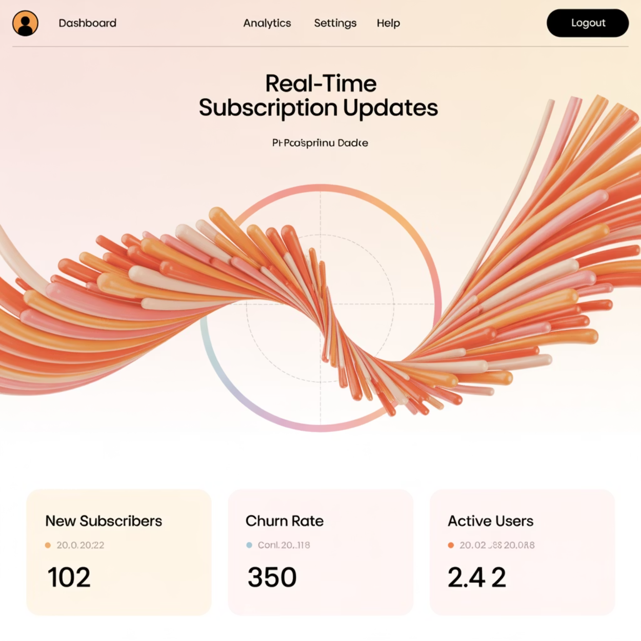
Subscriptions
// Subscription Type
[ExtendObjectType(Name = "Subscription")]
public class CourseSubscriptions
{
[Subscribe]
[Topic]
public Course OnCourseCreated(
[EventMessage] Course course)
{
return course;
}
}
// Publishing an Event
public async Task CreateCourse(
CourseInput input,
[Service] AppDbContext db,
[Service] ITopicEventSender eventSender)
{
var course = new Course { /* ... */ };
db.Courses.Add(course);
await db.SaveChangesAsync();
await eventSender.SendAsync(
"OnCourseCreated",
course);
return course;
}
Use Cases
WebSocket Protocol
Real-time dashboards
Uses WebSockets for efficient bidirectional communication
Chat applications
Notifications
Configuration
Live updates for collaborative apps
Requires additional middleware setup in ASP.NET Core pipeline

Slide 18
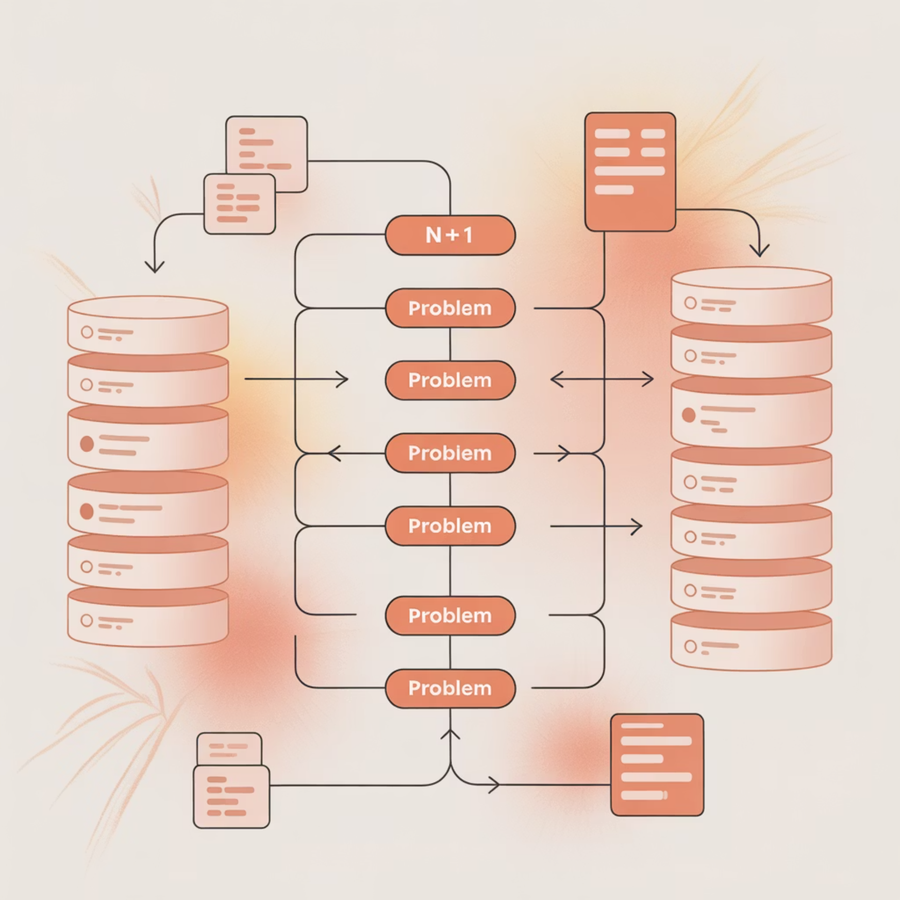
DataLoader Pattern
The N+1 Problem
DataLoader Solution
// Register the DataLoader
services.AddDataLoader();
// Define the DataLoader
public class UserDataLoader : BatchDataLoader
{
private readonly AppDbContext _dbContext;
public UserDataLoader(
AppDbContext dbContext,
IBatchScheduler scheduler)
: base(scheduler, new DataLoaderOptions())
{
_dbContext = dbContext;
}
protected override async Task>
LoadBatchAsync(
IReadOnlyList keys,
CancellationToken cancellationToken)
{
var users = await _dbContext.Users
.Where(u => keys.Contains(u.Id))
.ToDictionaryAsync(u => u.Id);
return users;
}
}
When fetching a list of objects and their related entities, naive implementations can cause one database query per parent object.
DataLoaders batch individual requests during a single execution cycle, dramatically reducing database load and improving performance for nested queries.
DataLoaders batch individual requests during a single execution cycle, dramatically reducing database load and improving performance for nested queries.

Slide 19

Pagination Strategies
Offset-Based Pagination
Cursor-Based (Relay) Pagination
[UsePaging(MaxPageSize = 50)]
public IQueryable GetCourses(
[Service] AppDbContext db)
{
return db.Courses.OrderBy(c => c.Title);
}
[UsePaging(
type: typeof(Course),
defaultPageSize: 10,
includeTotalCount: true)]
public async Task> GetCourses([Service] AppDbContext db)
{
return await db.Courses.OrderBy(c => c.Title).ToConnectionAsync();
}
Client query:
query {
courses(skip: 20, take: 10)
{
items {
id
title
}
pageInfo {
hasNextPage
hasPreviousPage
}
}
}
Client query:
query {
courses(first: 10, after: "YXJyYXljb25u...") {
edges {
node {
id
title
}
cursor
}
pageInfo {
endCursor
hasNextPage
}
totalCount
}
}
Enables slicing large result sets efficiently.
HotChocolate supports both offset-based and cursor-based (Relay) pagination.
Notes:
Cursor-based pagination is recommended over offset-based pagination for most use cases, especially when working with large, changing datasets.
Inconsistent Data ("Shifting Pages")
Performance on Large Datasets
No Clear End or Continuity
Why Cursor-Based Pagination Is Preferred
Cursor-based pagination uses a stable, opaque cursor (token) that represents the position in the list — not a numeric offset. The Difference Between edges and nodes
Nodes: The actual data items you're fetching (e.g., a list of Course objects).
Edges: A wrapper that includes both the node (data item) and its cursor. Using only nodes gives you the data, but no metadata (like cursors) for pagination.
Using edges gives you:
The data (node)
The cursor to fetch the next page
Optional additional metadata (e.g., sorting rank, position, timestamps)
query {
courses(first: 2,
where: {
or: [
{ name: { contains: "World" } },
{ name: { contains: "Algebra" } }
],
and: [
{ subject: { eq: HISTORY } },
]
},
order: [
{ name: ASC }
]
) {
nodes {
id
name
subject
}
pageInfo {
endCursor
hasNextPage
}
totalCount
}
}

Slide 20
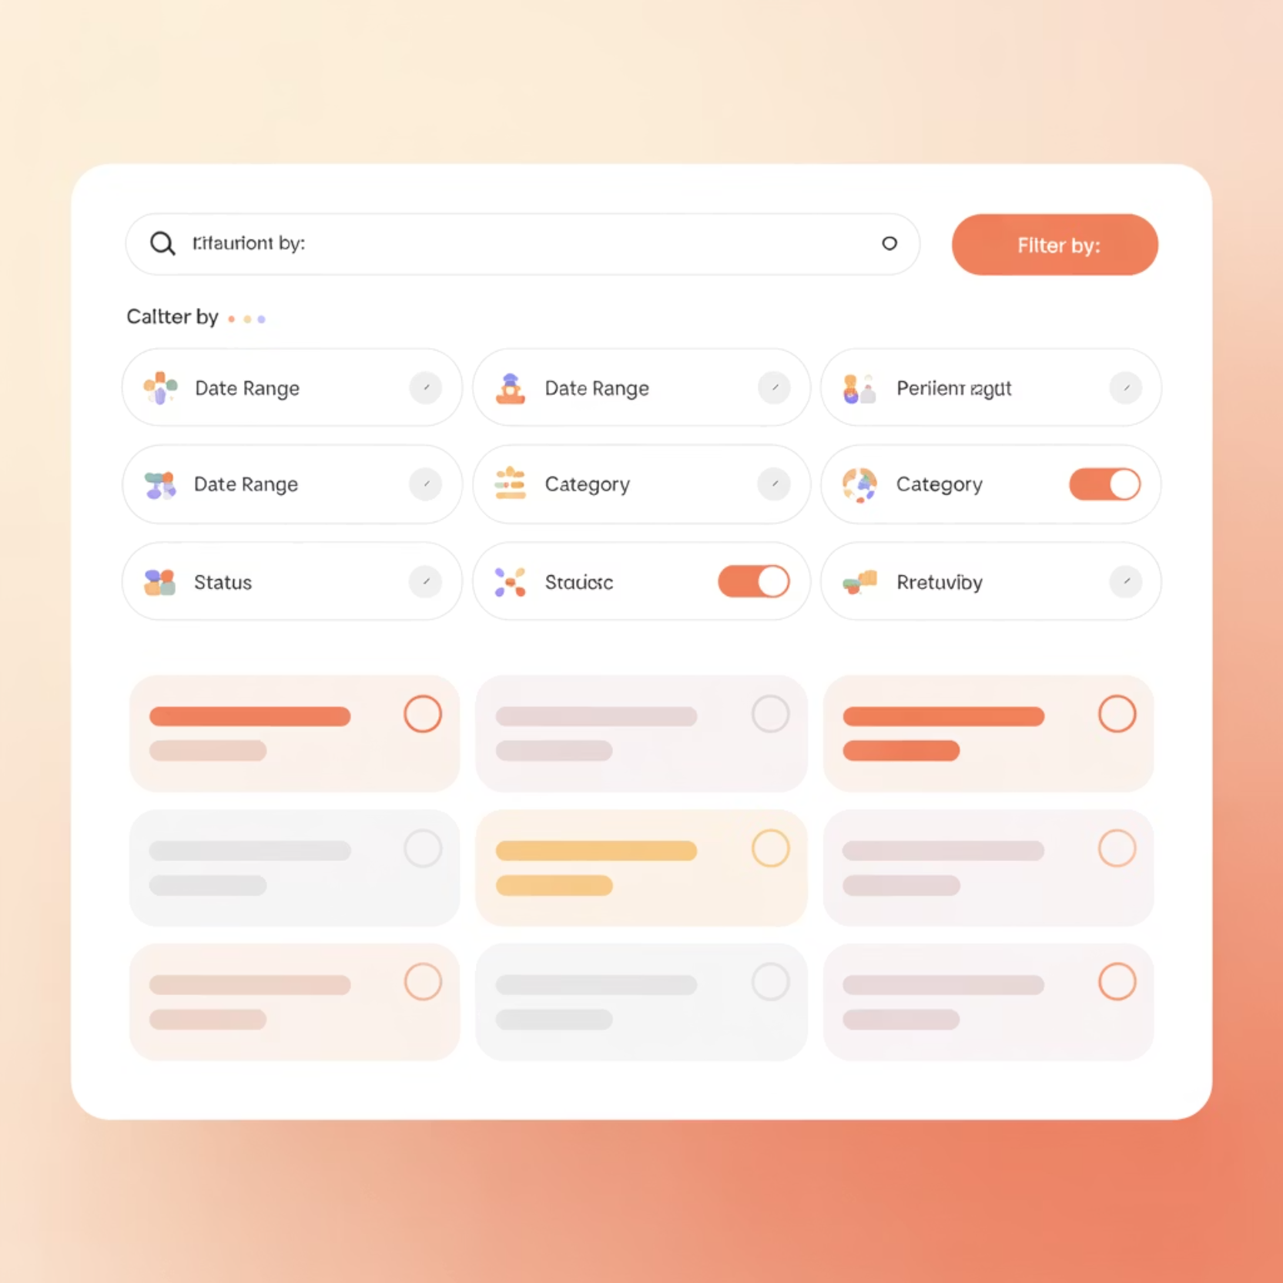
Filtering
Server Implementation
Client Query
[UseFiltering]
public IQueryable GetCourses(
[Service] AppDbContext db)
{
return db.Courses;
}
// Custom filter
public class CourseFilterInputType
: FilterInputType
{
protected override void Configure(
IFilterInputTypeDescriptor descriptor)
{
descriptor.BindFieldsExplicitly();
descriptor.Field(c => c.Title);
descriptor.Field(c => c.Description);
descriptor.Field(c => c.Difficulty);
descriptor.Field(c => c.Title)
.Name("titleContains")
.Type()
.Description("Custom filter that searches
for a substring");
}
}
query {
courses(
where: {
OR: [
{ title: { contains: "GraphQL" } },
{ title: { contains: "API" } }
],
AND: {
difficulty: { eq: INTERMEDIATE },
instructor: {
name: { contains: "John" }
}
}
},
order: [
{ title: ASC }
]
) {
id
title
difficulty
instructor {
name
}
}
}
HotChocolate's filtering capabilities generate complex query expressions that translate directly to efficient SQL through Entity Framework Core's query provider.
HotChocolate's filtering capabilities generate complex query expressions that translate directly to efficient SQL through Entity Framework Core's query provider.

Slide 21
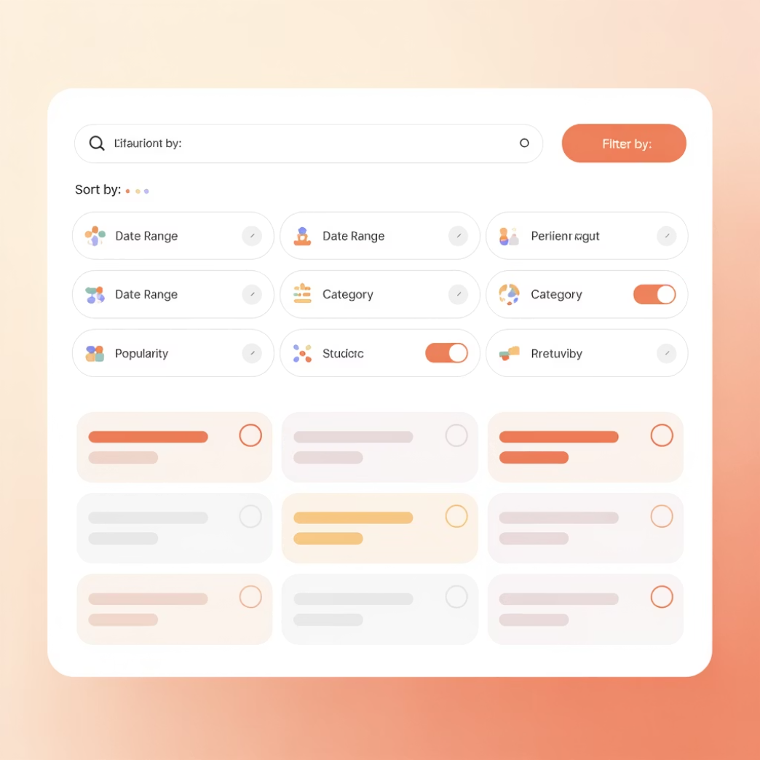
Sorting
Server Implementation
[UseSorting]
public IQueryable GetCourses([Service] AppDbContext db)
{
return db.Courses;
}
Client Query
query {
courses(
order: [
{ title: ASC }
]
) {
id
title
difficulty
instructor {
name
}
}
}
Declarative sorting by fields.
Supports multiple fields with asc/desc direction.

Slide 22
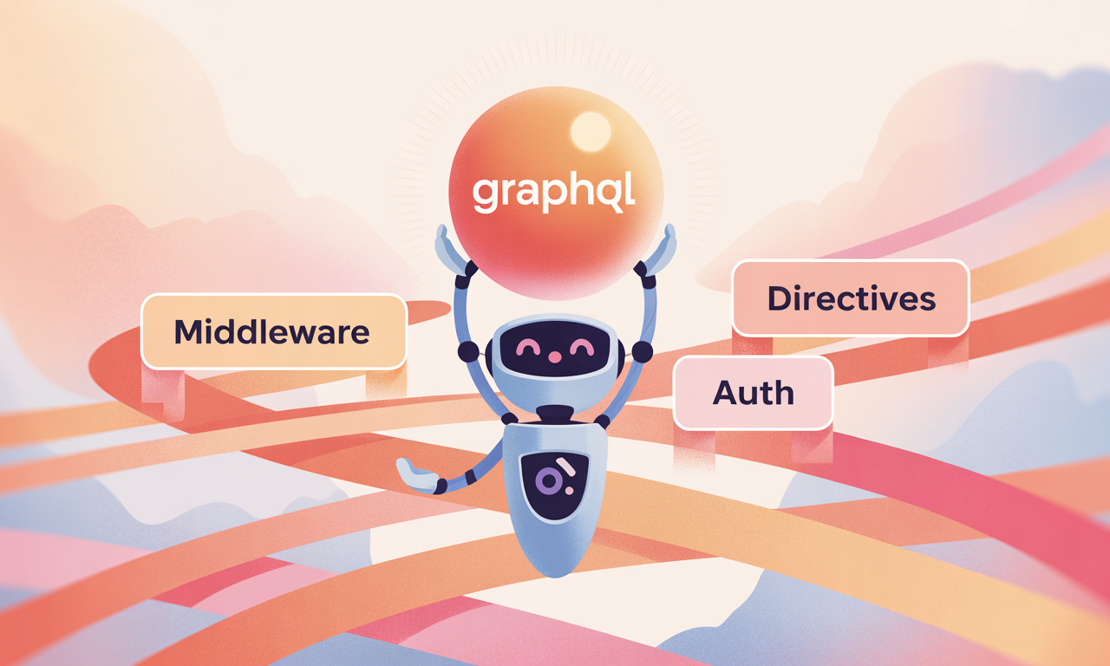
Middleware, Auth, Directives
Authorization
HotChocolate allows you to declaratively enforce authorization at the type or field level using the [Authorize] attribute.
You can apply role-based or policy-based access easily.
[Authorize(Roles = new[] { "Admin" })]
public class CourseMutation {
public Course DeleteCourse(int id) => /* ... */;
}
Middleware
Middleware in HotChocolate works like ASP.NET Core: it wraps resolvers.
This allows injecting logic before/after field execution (e.g., logging, caching, tracing).
public class LoggingMiddleware {
private readonly FieldDelegate _next;
public LoggingMiddleware(FieldDelegate next) => _next = next;
public async Task InvokeAsync(IMiddlewareContext context) {
Console.WriteLine($"Executing field: {context.Field.Name}");
await _next(context);
}
} //Register via services.AddGraphQL()
.AddTypeExtension<CourseQuery>()
.UseField<LoggingMiddleware>();
Directives
Directives allow modifying query behavior declaratively in the schema (like annotations). Example: a custom @deprecated-like directive for flagging internal fields.
public class MaskDirective : DirectiveType {
protected override void Configure(IDirectiveTypeDescriptor descriptor) {
descriptor.Name(\"mask\");
descriptor.Location(DirectiveLocation.Field);
}
} //Apply in Schema [GraphQLDirective(\"mask\")]
public string InternalNotes => \"Confidential Info\";

Slide 23

Error Handling and Validations
Structured and Manual Error Responses:
Exception Mapping with Filters and Validations
HotChocolate wraps all errors into a consistent GraphQL error format.
You get helpful metadata in the errors array, including path, locations, and custom extensions.
This makes it easier for frontend clients to handle errors gracefully.
You can return custom errors using ErrorBuilder, which lets you attach meaningful context and extensions:
You can map C# exceptions to GraphQL errors using IErrorFilter
You can plug in FluentValidation for complex, reusable validation logic.
Pair with GraphQL middleware to return field-level validation errors.
//Structured error
{
"errors": [
{
"message": "Course not found.",
"path": ["deleteCourse"],
"extensions": {
"code": "NOT_FOUND"
}
}
]
}
//Manual error
return ErrorBuilder.New()
.SetMessage("Course not found.")
.SetCode("NOT_FOUND")
.SetPath(context.Path)
.Build();
// Filters public class CustomErrorFilter : IErrorFilter {
public IError OnError(IError error)
{
if (error.Exception is DbUpdateException)
return error.WithMessage("Database update failed.")
.WithCode("DB_ERROR");
return error;
}
}
//Validators
public class CourseInputValidator : AbstractValidator<CourseInput>
{
public CourseInputValidator()
{
RuleFor(x => x.Title).NotEmpty().MinimumLength(3);
}
}

Slide 24

Performance Optimizations
✅ Use persisted queries for caching and security.
✅ Avoid deep query nesting (set MaxDepth).
✅ Use DataLoader to reduce DB calls.
✅ Tools: Banana Cake Pop, Apollo Studio (for federated systems)
Common Pitfalls
❌ N+1 issues due to naive resolver nesting.
❌ Not limiting query depth.
❌ Overexposing internal types (bad nullability, overly broad schemas).
Notes:
MaxDepth is a query validation rule in GraphQL that limits the maximum depth of nested fields a client can query.
This helps prevent performance issues and abuse from deeply nested or recursive queries that could overwhelm your server or database.
query {
user {
friends {
friends {
friends {
... (repeat)
}
}
}
}
}
Very expensive query execution
Stack overflow
DB joins explosion
Denial-of-Service (DoS) risk

Slide 25

References
https://graphql.org
https://spec.graphql.org
https://github.com/graphql
https://chillicream.com/docs/hotchocolate
https://www.apollographql.com/docs
https://www.apollo-angular.com/docs/
https://youtu.be/iOQ74eYU2U4?si=_5LCB-3vOtHFlrKH

Slide 26


